Slide 1

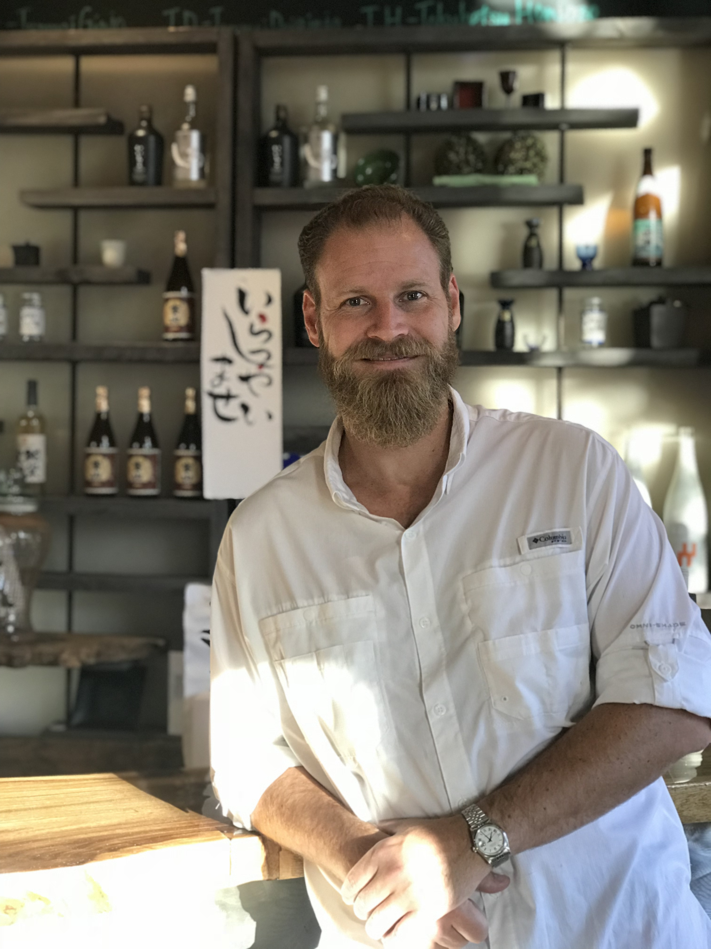






Sake Educational
Session in Houston
26
ABOUT THIS EVENT
This sake seminar and tasting event will feature an introduction to sake by Guilherme “William” de Macedo and a presentation of different sakes from across Japan as well as a comparison between sake and wine. Come join us for an educational afternoon on the qualities of Japanese sake.
This event is for food and beverage professionals only, and is not available to the general public.
February 2019
2:30pm-4:00pm
Venue: The Texas Wine School
2301 Portsmouth St, Houston, TX 77098
EVENT HIGHLIGHTS
REGISTER HERE
Cost: Free
https://www.jetro.go.jp/form5/pub/hut/sakehouston
*All attendees must be 21 years of age or older to try alcohol.
An informational lecture by Guilherme “William” de Macedo
Sake samples from different regions in Japan
Comparison between sake and wine
Sake food pairings with several kinds of cheese
GUEST SPEAKER
Supported by:
Guilherme “William” de Macedo is a Certified Sake Sommelier and a Sake Educator by the Sake Sommelier Association (SSA). He is a Japanese Sake Adviser by the SSI (Sake Service Institute) and has the WSET Level 1 in Sake. He is also a Certified Sake Professional by the Sake Education Council, having studied with John Gaunter.
Talk to JETRO first.
www.jetro.go.jp/usa
713.759.9595
hut-seminar@jetro.go.jp
1221 McKinney Street, Suite 4141
Houston, TX 77010
Notes:
FEEL FREE TO:
Swap out image on top for different image.
Modify text (do not modify width of paragraphs; the left paragraph must remain the same width and the right paragraphs must remain one of the two width options shown).
Change the colors of the top box and bottom box (behind JETRO logo). Use one of the four RECENT COLORS for this change.
Modify contact information to your office specifications.
DO NOT:
Deviate from the three column layout. This design is based on three columns. Content can be stretched across all three columns (see page three example), stretched across two columns (with one leftover), or broken down to all three columns. However, do not rearrange content so it is based on a four-column design. This is against JETRO’s original brand guidelines.
Use non-designated colors.
Change the fonts. These are our official brand fonts.

