Slide 1

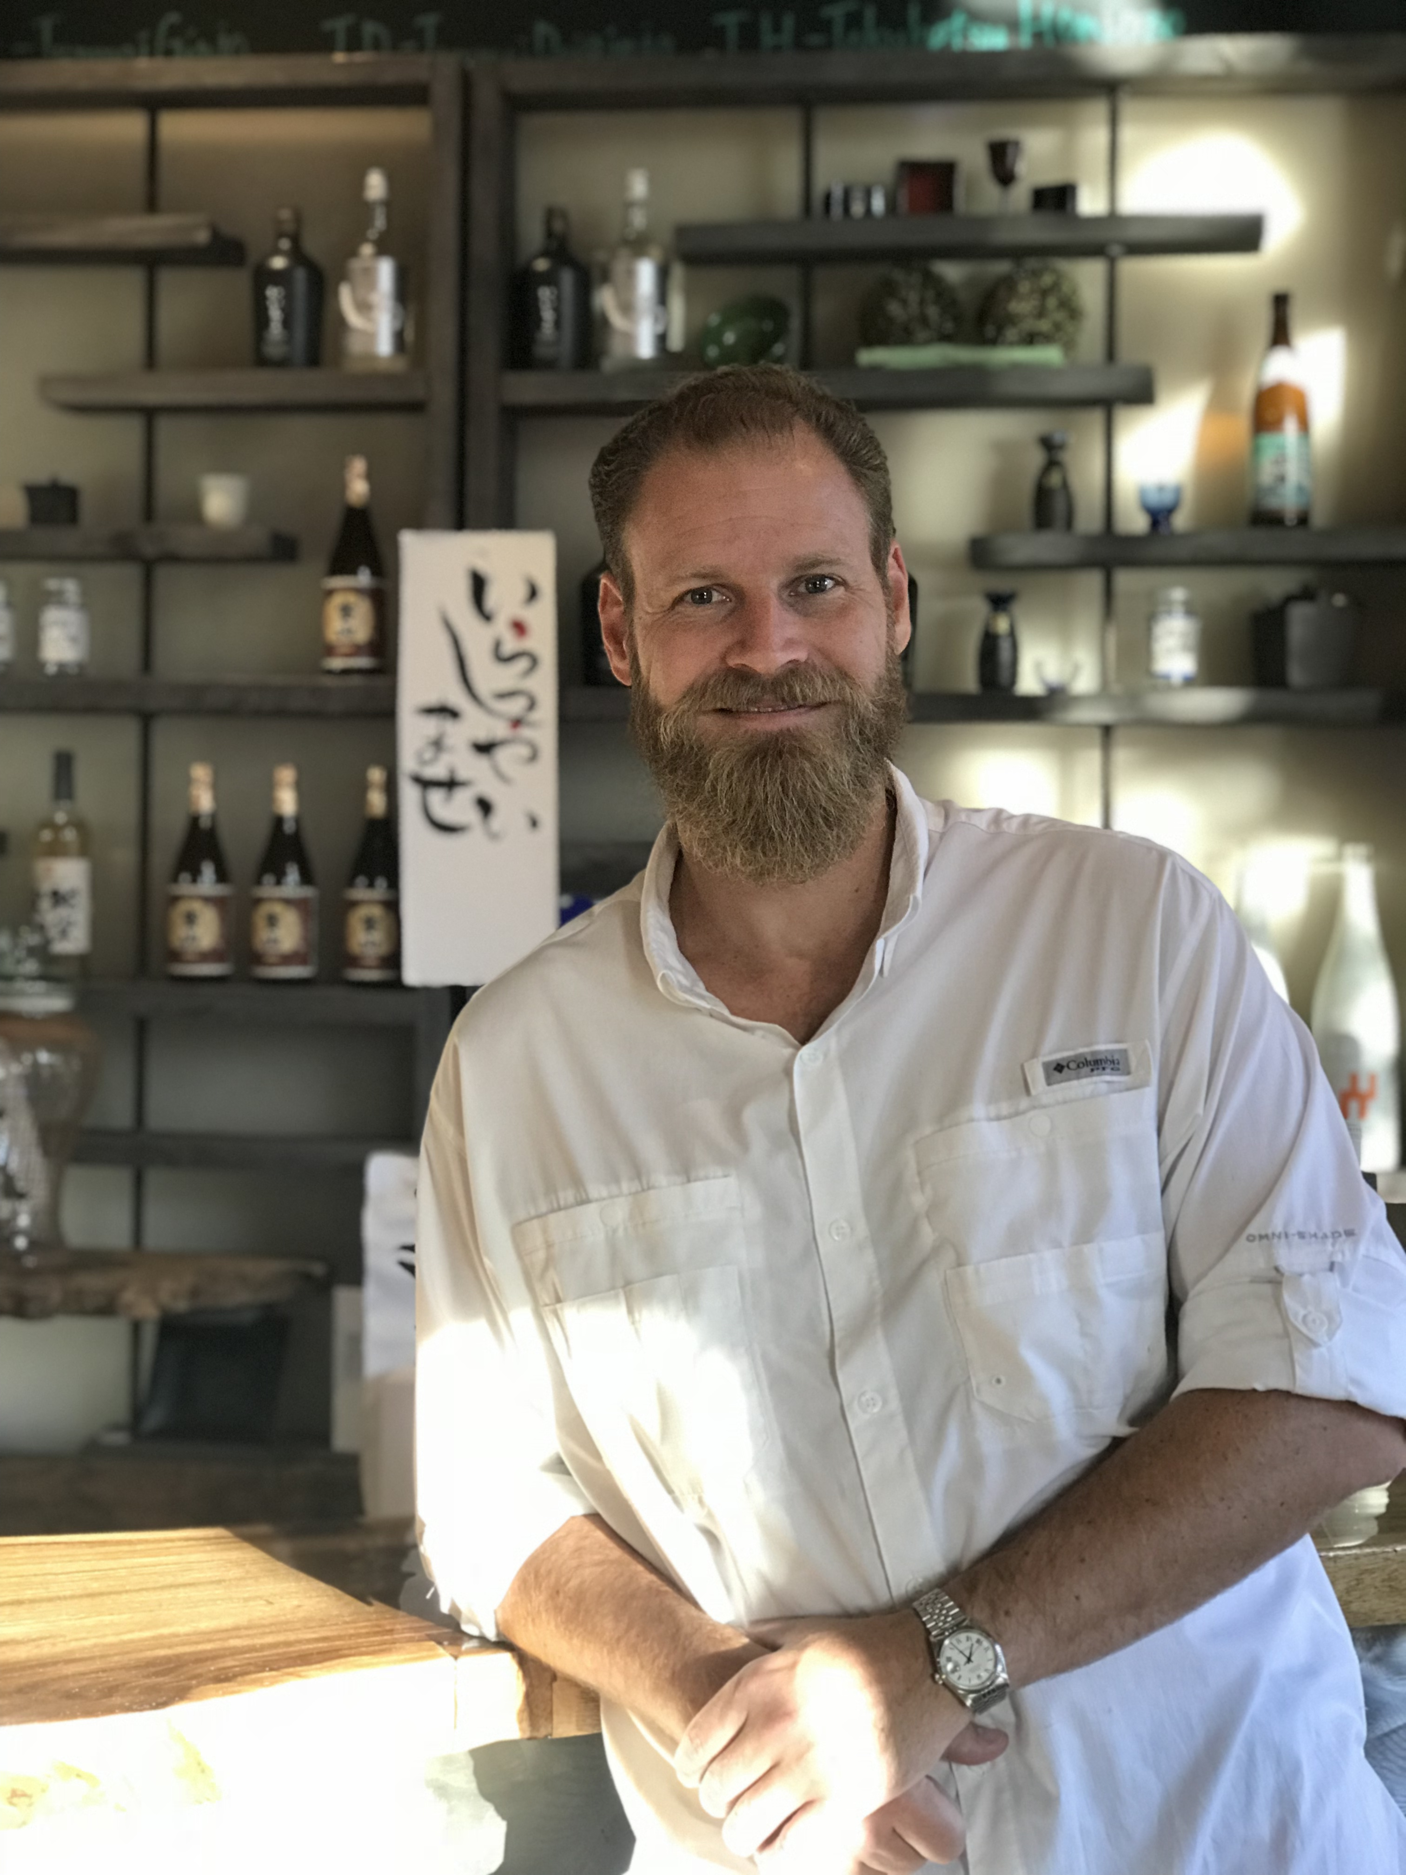


Sake Educational Session &
Business Meetings in Dallas
28
February 2019
12:30pm-1:30pm Free Tasting & Business Meetings Session 1
1:30pm-2:30pm Sake Seminar with Tasting
2:30pm-4:00pm Free Tasting & Business Meetings Session 2
Please join us and your industry peers at a special sake tasting and seminar presenting premium, authentic sake from Japan!
Sample and compare types of sakes and styles - each distinct in flavor and notes.
This event is for food and beverage professionals only, and is not available to the general public.
EVENT HIGHLIGHTS
Seminar
An informational lecture by Guilherme “William” de Macedo
Sake samples from different regions in Japan
Comparison between sake and wine
Sake food pairings with several kinds of cheese
Guilherme “William” de Macedo is a Certified Sake Sommelier and a Sake Educator by the Sake Sommelier Association (SSA). He is a Japanese Sake Adviser by the SSI (Sake Service Institute) and has the WSET Level 1 in Sake. He is also a Certified Sake Professional by the Sake Education Council, having studied with John Gaunter.
Free Tasting & Business Meetings
Free Tasting & Business Meetings Sessions will be arranged with breweries producing exquisite sakes for possible business co-operation with you.
During the meeting, the delegates will present their product samples to facilitate discussion.
<Attending Brewers>
●Hakutsuru Sake Brewing (Hyogo Pref.)
http://www.hakutsuru.co.jp/english/
●Nanbu Bijin (Iwate Pref.)
https://www.nanbubijin.co.jp/en/
●Obata Shuzo (Niigata Pref.)
https://www.obata-shuzo.com/en/
●Yasufuku Matashirou Shouten (Hyogo Pref.)
http://daikoku-m.com/index.html
REGISTER HERE
Cost: Free
https://www.jetro.go.jp/form5/pub/hut/sakedallas
Venue:
Sushi Rock
7601 Campbell Road Suite Dallas, TX75248
*All attendees must be 21 years of age or older to try alcohol.
For Free Tasting & Business Meetings:
For Seminar:
+81-3-6407-9887
japan.sake-promotion@pasia.co.jp
713.759.9595
hut-seminar@jetro.go.jp
Notes:
FEEL FREE TO:
Swap out image on top for different image.
Modify text (do not modify width of paragraphs; the left paragraph must remain the same width and the right paragraphs must remain one of the two width options shown).
Change the colors of the top box and bottom box (behind JETRO logo). Use one of the four RECENT COLORS for this change.
Modify contact information to your office specifications.
DO NOT:
Deviate from the three column layout. This design is based on three columns. Content can be stretched across all three columns (see page three example), stretched across two columns (with one leftover), or broken down to all three columns. However, do not rearrange content so it is based on a four-column design. This is against JETRO’s original brand guidelines.
Use non-designated colors.
Change the fonts. These are our official brand fonts.

