Slide 1
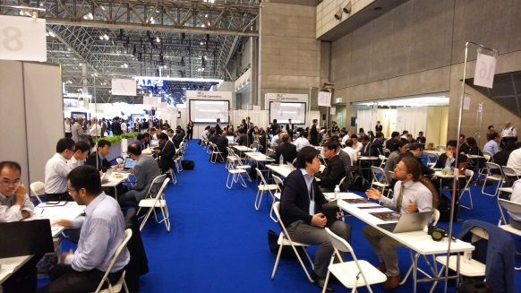
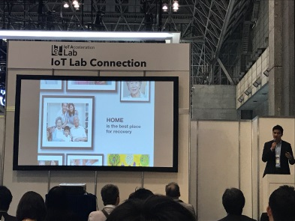
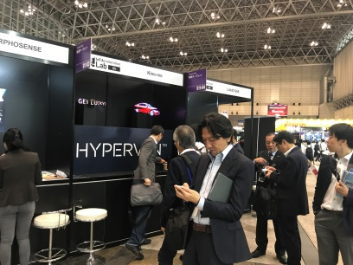
IoT Acceleration Lab / Global Connection 2018
IoT Acceleration Lab will implement “Global Connection 2018” at CEATEC in Japan on October 2018, as same as last year event.
IoT Acceleration Lab will invite overseas startups, such as ASEAN, India, Israel, EU, and Russia, will provide business opportunities, such as business matching with Japanese companies , pitching session and exhibition booth.
IoT Acceleration Lab will promote business collaboration and global IoT business.
Business Matching
Pitching Session
Exhibition Booth
Japanese companies and overseas startups will have some short business meetings.
Overseas startup will have a short presentation.
Overseas startup can set up their exhibition booth.

Slide 2
Business Opportunity with Japanese Companies
IoT acceleration Lab will provide business opportunities for selected companies in CEATEC.
Free Exhibition Booth and pitching session in CEATEC
Business Matching Opportunity with Japanese companies
IoT Business Matching Opportunity
in CEATEC
Opportunity 1
Opportunity 2
CEATEC is one of the biggest IT/electronics exhibition in Japan.
（152,066 visitors in 2017）
Selected companies in ASEAN, India, Israel and EU will be free for travel and accommodation for one person.
Free Exhibition Booth
and pitching session
at CEATEC in 16th to 19th , Oct
Business Matching
with Japanese companies
What you have to do
3 steps to go
Step 1
[June 11 – June 29 ]
Step 2
[mid August]
Step 3
[mid Oct.]
Japanese companies evaluate the application
Register and fill in the application form
(https://iotlab.jp/en/)
Selected companies receive the invitation to Japan
Visit Japan and
have business matching opportunity at CEATEC

