Slide 1


The Role of Japan
- leading global economic rules -
Koichi Akaishi
Director-General for Trade Policy
Ministry of Economy, Trade, and Industry
Takayuki UEDA
Vice-Minister for International Affairs,
Ministry of Economy, Trade and Industry, Japan
Fifth EU Asia Top Economist Round Table
EU Japan Economic Forum
Tokyo, 14 November 2014
Building a ‘Bridge’ between the Asia Pacific and the EU
-The Strategic Significance of the EU-Japan FTA/EPA-
Paris, 10 February 2016
Notes:
● Thank you for coming today.
● I’m Takayuki UEDA, vice-minister for International
affairs, ministry of Economy, Trade and Industry, Japan
● In this session, I’d like to introduce about Japan’s recent trade
policy.

Slide 2
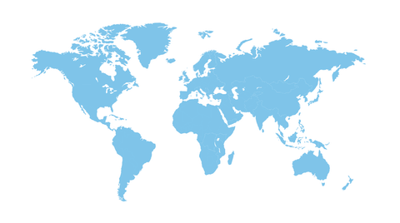
Two Ways forward – a crossroad in the global economy -
open market,
sustainable society,
innovative
closed market,
exhaustive,
conservative
Which way to go?

Slide 3
Japan’s Trade Policy
Multilateral/Plurilateral Negotiations in WTO
e.g.
Information Technology Agreement (ITA) expansion
Environmental Goods Agreement
Bilateral EPA/FTA
e.g.
Japan-EU EPA/FTA
Trans-Pacific Partnership (TPP)
Regional Comprehensive Economic Partnership (RCEP)
Japan, China, South Korea, India, Australia, New Zealand + ASEAN
Level of liberalization
ＥＰＡ／ＦＴＡ
high
Ｗ Ｔ Ｏ
Custom duties are reduced equally to all member countries
Custom duties are reduced only to bilateral countries

Slide 4
Japan’s goal in global trade
Increase FTA/EPA ratio from 19%(2012) to 70% (by 2018)
37.3%
GCC
10.9%
USA
13.3%
2012
2016
South Korea
6.3%
in force/Signed/Agreed Under Negotiation Others
3
Notes:
3
● Do you know “Japan Revitalization Strategy“?
● The government’s “Japan Revitalization Strategy” was
approved by the cabinet in June, 2013.
● “Third arrow” of the prime minister’s “Abenomics” program,
the strategy comprises three broad action plans, along with
some concrete targets and measures to bring them about.
● Main pillars of the strategy:
(1) Plan for the Revitalization of Japanese Industry,
(2) Strategic Market Creation Plan, and
(3) Strategy of Global Outreach.
● One of the main growth targets included in the “Japan
Revitalization Strategy, Japan will increase FTA ratio form
19% as of 2012 to 70% by 2018. Now, Japan has reached
37.2% .

Slide 5
Trans-Pacific Partnership(TPP)
TPP is the 21st century style rules: IPR, E-commerce, SOE, and environment , etc.
Canada
Japan
Vietnam
USA
Mexico
Malaysia
TPP
Peru
Brunei
Chile
Singapore
Australia
New Zealand
Investment Protection
Trade in Services
E-Commerce
national treatment （NT） and MFN for the pre and post-Establishment
ISDS（Investor-State Dispute Settlement）
open markets including AV service by “negative list approach”
temporary entry for business persons in a timely and transparent manner
not to impose custom duties on digital products
Against source-code disclosure/ server requirements
free cross-border data flows etc.
.
Notes:
● At the Trans-Pacific Partnership (TPP) Ministerial Meeting held
in Atlanta, United States, on October 5, an agreement in
principle was reached on the TPP Agreement.
● Since the participation in the negotiations in July 2013, Japan
has had many constructive discussions with the other
participating countries in pursuit of the best path to suit our
national interests, with a view to realizing a TPP Agreement
that will establish new 21st century trade rules in a wide range
of areas.
● This agreement in principle is expected to serve as a
foundation for the building of a broader free trade area in the
Asia-Pacific region, and to provide the momentum to push
forward other economic partnership negotiations that Japan is
pursuing.

Slide 6

Development of Japan’s FTA/EPA Networks
China-Japan-Korea FTA
Japan-EU・EPA
RCEP
( Regional Comprehensive Economic Partnership )
TPP
（Trans-Pacific Partnership）
29% of world GDP
36%of world GDP
In force/Signed/Agreed
Under Negotiation
56% of world GDP
Source : worldbank.org
Notes:
● In this slide, I talk about development of Japan’s FTA/EPA Networks.
● Now, Japan’s FTA/EPA covered share 37.2% including TPP.
● Japan has signed , agreed, and come in force 14 countries and 2
regions,and 4 countries and 4 regions under negotiation.
● As you know, many enterprises are running the business by the world
scale, but they’re facing many problems like custom duties, non tariff
measures, IPRs and so on.
● Japan recognize the importance of conclusion of wide area FTA/EPA.

Slide 7
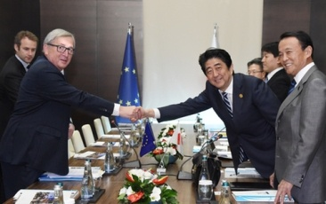
Japan-EU Summit Meeting (November 2015)
The two leaders shared the view that they would instruct their respective chief negotiators to accelerate the EPA/FTA negotiations and continue to do their utmost efforts to reach agreement in principle this year, and, if not, to achieve such agreement at the earliest possible time in the course of next year.

Slide 8
Thank you.
Koichi Akaishi
Director-General for Trade Policy
Ministry of Economy, Trade, and Industry
Takayuki UEDA
Vice-Minister for International Affairs,
Ministry of Economy, Trade and Industry, Japan
Fifth EU Asia Top Economist Round Table
EU Japan Economic Forum
Tokyo, 14 November 2014
Building a ‘Bridge’ between the Asia Pacific and the EU
-The Strategic Significance of the EU-Japan FTA/EPA-
Paris, 10 February 2016

