Slide 1
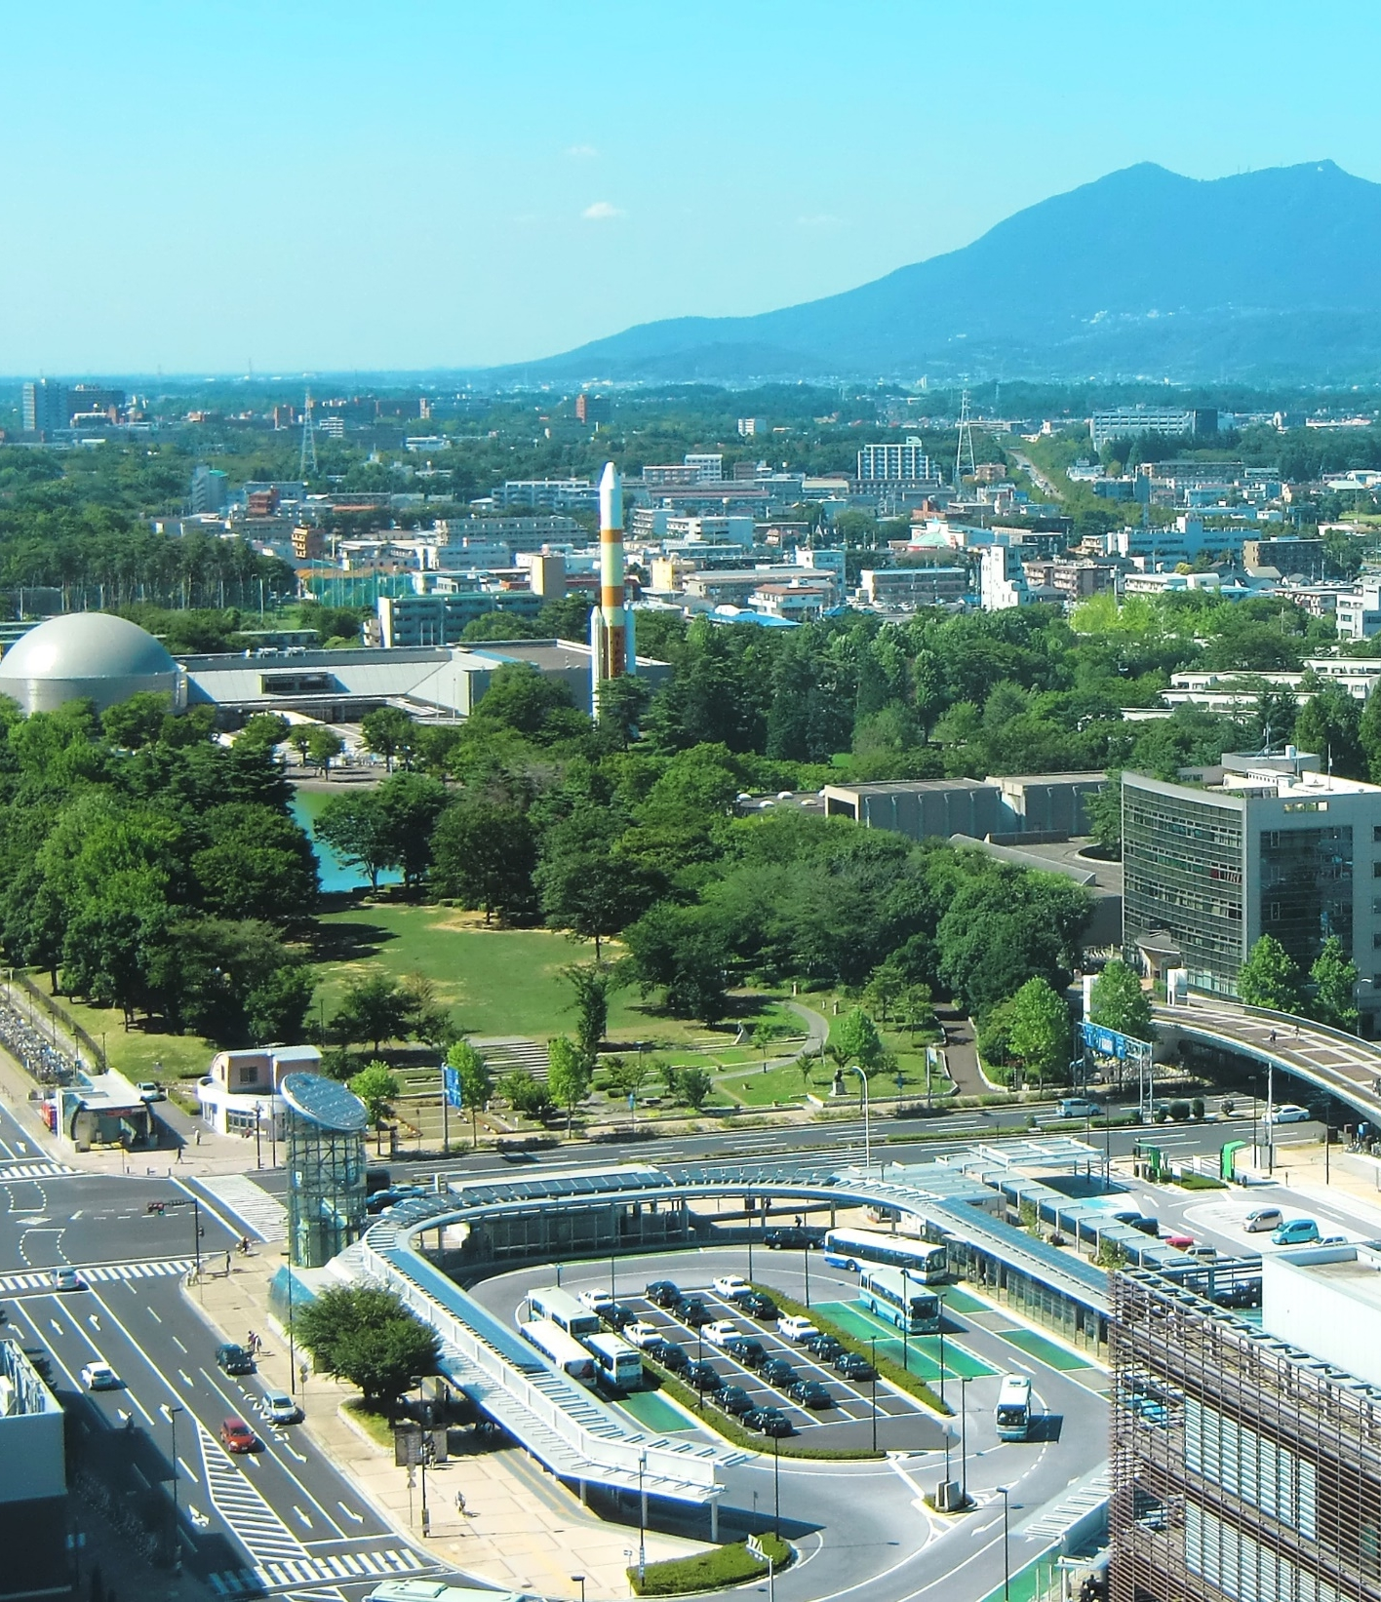
Ibaraki Prefectural Government
Building a Bridge with International Businesses
The Ibaraki Prefectural Government is providing business matching support and other incentives to attract international businesses to Tsukuba City in Ibaraki Prefecture
Make Innovations Happen in Tsukuba!
Notes:
Hello and thank you for taking an interest in Ibaraki Prefecture as a potential candidate for furthering your business endeavors. Here at the Ibaraki Prefectural Government, we offer business matching support and as well as a variety of other incentives in an effort to attract foreign enterprises to Tsukuba City, located in Ibaraki Prefecture, Japan.

Slide 2
Make Innovations Happen in Tsukuba!
Ibaraki
Prefectural
Government
What Tsukuba is Targeting:
Foreign R&D companies focusing on the life science field
Foreign companies aiming for high growth using innovative technologies such as IoT & robotics
Benefits:
For international companies looking for business partners in Japan
In Tsukuba, there are excellent companies, research institutions, and universities that are
suitable for collaboration, technological tie-ups, and joint research.
For international companies considering setting up an R&D base in Japan
Tsukuba is the perfect environment, as it is located close to Tokyo and has a high concentration
of research institutes.
Heart of Japan’s strategic R&D:
Over 30% National Research and Educational Facilities
If your company is considering expanding into Japan, please get in touch to explore the range of incentives and business matching support offered in Ibaraki
Notes:
Tsukuba is targeting foreign R&D companies that are centered around the life science field, such as the healthcare industry, pharmaceutical industry, biomedical technologies, and so forth. This includes companies aiming for high growth using innovative technologies such as Internet of Things (IOT) which is used for diagnosing, systematic monitoring, and developing of well-being devices, and others. Additionally, there is a focus on robotics whether it is autonomous robots, nursing robots, therapeutic robots, and so forth. Many institutions in Tsukuba City are open to joint research and other kinds of collaboration with foreign companies. Tsukuba is conveniently located near Tokyo, making it an ideal location for foreign companies looking to reduce costs while still retaining accessibility, and it is also home to over 30% of national research and educational facilities, making it the heart of Japan's strategic R&D.

Slide 3
About Tsukuba ~ Hub of cutting-edge science technology ~
Ibaraki
Prefectural
Government
Unique city of highly educated and innovative scientists
Over 20,000 registered researchers
About 7,900 PhDs from various scientific backgrounds
Over 7,200 non-Japanese scientists – highly internationalized
*Numbers of researchers are as of June 2017
Reuters’ ranking of The World’s Most Innovative Research Institutions 2019
 | Research Institutes | countries
1 | Health & Human Services Laboratories | USA
2 | Fraunhofer Society | Germany
3 | Alternative Energies and Atomic Energy Commission | France
~
6 | RIKEN (Japan's largest comprehensive research institution) | Japan “Tsukuba”
7 | National Institute of Advanced Industrial Science and Technology (AIST) | Japan “Tsukuba”
~
14 | National Institute of Materials Science (NIMS) | Japan “Tsukuba”
Notes:
Tsukuba is a unique city of highly educated and innovative scientists with over 20,000 researchers, over 7000 of which are foreign nationals.
In Reuters ranking of the world's most innovative research institutions in 2019, RIKEN, renowned for high-quality research as Japan's largest comprehensive research institution, placed 6th.
Following RIKENS placement is the National Institute of Advanced Industrial Science and Technology (AIST) which was 7th. AIST is one of the largest public research organizations in Japan and prides itself on bridging the gap between innovative technologies and commercialization. The National Institute of Materials Science (NIMS), an organization that has promoted research covering anything from metals, ceramics, organic materials, and biomaterials in an effort to build a sustainable society, came ranking in at 14th. All of these organizations are located in Tsukuba.

Slide 4
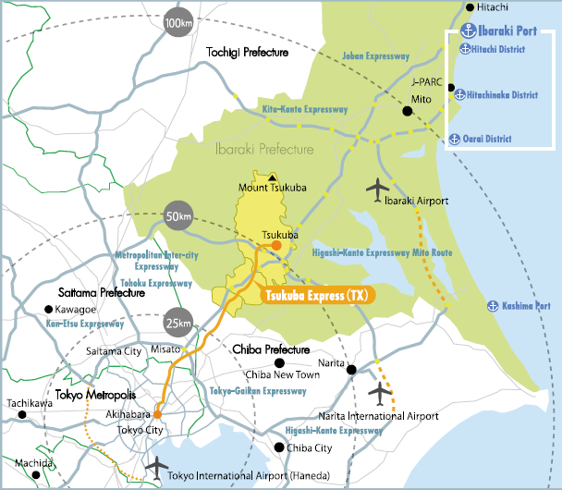
About Tsukuba ~ Conveniently Located Near Tokyo ~
Ibaraki
Prefectural
Government
Hitachi
Hitachi
Founding region of Hitachi,Ltd.
Tokyo to Tsukuba
45 min by Train
Narita International Airport to Tsukuba
55 min by Airport Bus or
45 min by Car
Tsukuba
Narita
Tokyo
Notes:
Tsukuba City is about 50 kilometers from the center of Tokyo, with it only taking 45 minutes to get there by train. Narita International Airport is also only a 45 minute journey by car, making it a prime location for international travelers. Hitachi City in Ibaraki Prefecture is also the founding region of Hitachi, Ltd., where there is an abundance of manufacturing plants. As a result, there are many skilled technicians in the city with a great deal of expertise.

Slide 5
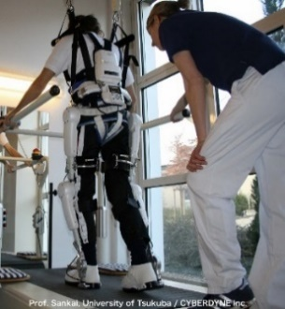
About Tsukuba ~ creating business opportunities~
Ibaraki
Prefectural
Government
Foreign companies also run their business in Tsukuba - for example:
iASYS Technology Solutions Parent company in Pune, India
Provide IT solutions to engineers involved in manufacturing and Research & Development
In July 2020, the Cabinet Office of Japan selected Ibaraki Prefecture and Tsukuba City as "Global Hub Cities" as part of a national strategy to create leading global ecosystems
Centered on central Tokyo, where startups, VCs, large corporations and other supporters are gathered, and connected to cities with R&D bases (such as Tsukuba) through hub-and-spoke collaboration.
Collaboration with overseas technology hubs (Silicon Valley, Boston).
More than 350 startups were born from the Tsukuba area - for example:
TOKIWA-Bio AIST Start-up
R&D and manufacture of gene therapy drugs, etc.
Developed stealth RNA vectors (SRV), an innovative technology for gene expression systems
CYBERDYNE Start-up from the University of Tsukuba
R&D, manufacture, and sales of wearable cyborg-type robot HAL®, etc.
Cyberdyne Care Robotics GmbH is located in Bochum, Germany
Notes:
Foreign companies also run their business in Tsukuba, for example IASYS, a digital solutions company originally located in India that provides products and solutions utilizing the latest technology and also for research and product development domains to engineers and researchers.
In 2020, the Cabinet Office of Japan selected Ibaraki Prefecture and Tsukuba City as "Global Hub Cities" as part of a national strategy to create leading global ecosystems. Over 350 startups were born from the University of Tsukuba, AIST and other research facilities based in Tsukuba. Some of the startups that were born are TOKIWA-Bio, an R&D manufacturer of gene therapy drugs that developed innovative technologies for gene expression systems. CYBERDYNE, prominently known for the R&D, manufacturing, and sales of the wearable cyborg-type robot HAL.
外資系企業もつくばで事業を展開しており、例えば、もともとインドに拠点を持つデジタルソリューション企業のIASYSは、最新技術を活用した製品やソリューションを提供し、技術者や研究者に対しては研究・製品開発領域にも対応しています。
2020年、内閣府は、世界をリードするエコシステムの構築を目指す国家戦略として、茨城県とつくば市を「世界拠点都市」に選定しました。筑波大学や産業技術総合研究所など、つくばに拠点を置く研究施設から350を超えるスタートアップが誕生しています。誕生したスタートアップの一部を紹介すると、遺伝子発現系の革新的な技術を開発した遺伝子治療薬の研究開発メーカー「トキワバイオ」。 ウェアラブルサイボーグ型ロボット「HAL」の研究開発・製造・販売で有名なCYBERDYNE社などが挙げられます。

Slide 6
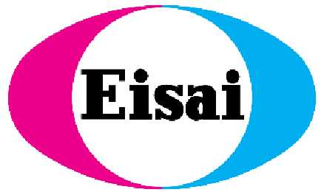
About Tsukuba ~ Tsukuba Life Science Promotion Association ~
Ibaraki
Prefectural
Government
About TLSK
Technical Areas
TLSK was established in February, 2012 as a foundational organization of the Tsukuba International Strategic Zone.
Mission: To promote collaborative research & development in the life science field in the Tsukuba district.
Pharmaceutical
Agriculture, Food
Bioresource platform
Others
Members
Over 60 organizations including private sector companies, academic institutes & local government
Notes:
The Tsukuba Life Science Promotion Association, also known as TLSK, is an open innovation platform that was established in 2012 as a basic organization of the Tsukuba International Strategic Zone. Their aim is to promote collaborative research and development in the life science field within Tsukuba. Ibaraki Prefectural Government is a member of the association and we focus our efforts on finding suitable matches for potential partners for companies looking to conduct joint research and collaborate within the region. Currently TLSK hosts over 60 members, organizations that range from private sector companies in the pharmaceutical and health care industries such as KYOWA, astellas, Eisai and so forth, as well as academic institutions and local governments.

Slide 7
Our Incentives: Subsidies
Ibaraki
Prefectural
Government
Ibaraki Prefectural Government arranges;
Joint Research Trial Subsidy [Maximum of 2 million yen*]
・ Subsidy for joint research trial conducted by foreign-owned businesses and universities, laboratories,
businesses and other institutions in the prefecture
Subsidy for the Establishment of a Project Facility [Maximum of 6.4 million yen*]
・Subsidy for foreign-affiliated companies that newly establish business bases in the prefecture
・ Establishment Expenses Subsidy ［Within 50%, up to 2 million yen］
・ Rent Subsidy ［Within 50%, up to 2.4 million yen］
・ R&D Expenses Subsidy ［Within 25%, up to 2 million yen］
*1 million yen ≒ 7,335 dollars/7,020 euros (as of June 30th, 2022)
Notes:
Ibaraki Prefectural Government offers incentives to foreign entrepreneurs or companies based on the following activities:
A Joint Research Trial Subsidy with a maximum of 2 million yen, applicable toward labor costs, subcontract costs, supply costs and other expenses related to research and development with local institutes or companies.
A Subsidy for the Establishment of a Project Facility based around 3 different categories.
The first category, Establishment Expenses Subsidy covers:
Marketing research expenses when establishing the corporation.
Expenses for every type of registration when establishing the corporation.
Expenses to obtain residency.
Expenses for translation and interpretation of the above listed.
This is allocated to half of the total expenses, or a maximum of 2 million yen, whichever amount is smaller.
The second category covers Rental expenses for 12 months after the rental start date allocated to half of the total expenses, or a maximum of 2.4 million yen, whichever amount is smaller.
The third category covers R&D Expenses such as labor expenses, subcontract expenses, supplies expenses, depreciation expenses and other related costs allocated to a quarter of the expenses, or a maximum of 2 million yen, whichever is smaller.

Slide 8
Our Incentives: Business Matching Support by Advisor for Business Matching and Investment in Ibaraki
Ibaraki
Prefectural
Government
Advisors for Business Matching and Investment are experts in the life science field and have a wide network of researchers and private companies.
They will listen to the technological needs of foreign companies and help match them with appropriate research institutions and other partners of the prefecture. *
Ibaraki Prefectural Government
(Business Matching Support)
Listen to technological needs
International
Companies
Advisor for Business Matching and Investment
Research Institutes
Universities
Private Companies
Match with appropriate research institutes, etc.
*Depending on the needs, we may not be able to introduce a matching partner.
8
Notes:
The Ibaraki Prefectural Government has a specific network of highly skilled professionals and experts and in the life science and health care industries. This network enables us to provide excellent business matching support that is tailored to the needs of foreign companies looking to expand into Japan by listening to the technological needs of companies, and subsequently pairing them with the appropriate research institutions and other partners in the prefecture.

Slide 9
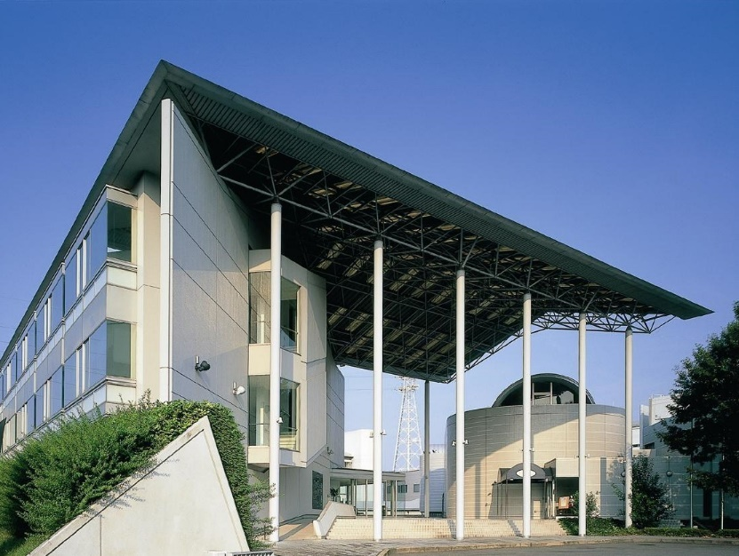
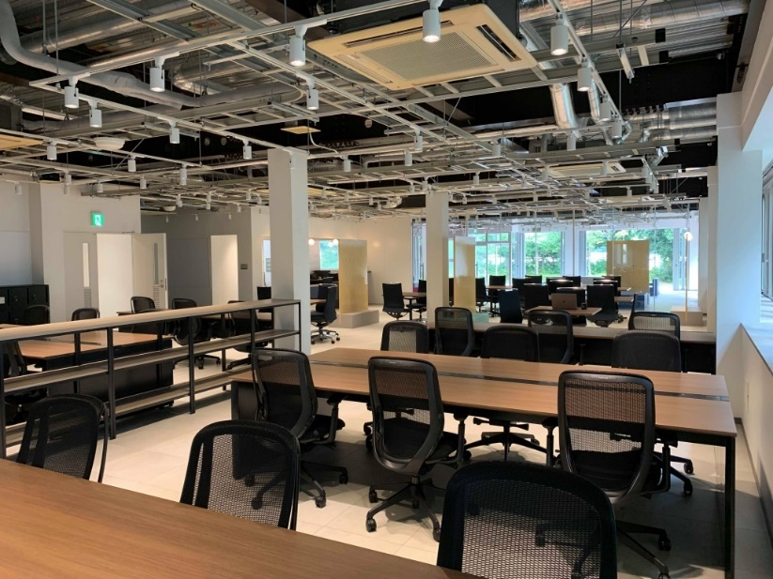
Our Incentives: Incubation Facilities
Ibaraki
Prefectural
Government
Ibaraki also helps companies to establish themselves in Japan more easily, with low start-up cost, through access to incubation facilities such as:
Tsukuba Center lnc.
Promote communication between researchers
and support new business development
Tsukuba Start Up Park
Co-working space
・ 18,000 yen/month (as of June 2022)
・ Corporate registration possible
9
Notes:
The Ibaraki Prefectural Government has a specific network of highly skilled professionals and experts and in the life science and health care industries. This network enables us to provide excellent business matching support that is tailored to the needs of foreign companies looking to expand into Japan by listening to the technological needs of companies, and subsequently pairing them with the appropriate research institutions and other partners in the prefecture.

Slide 10
In Conclusion
Ibaraki
Prefectural
Government
Ibaraki Prefecture has a wide network of research institutions and private companies
We are able to give support to global R&D companies focusing on the life science field and
firms aiming for high growth using innovative technologies such as IoT & robotics also
related in healthcare industries.
Business matchmaking support and various incentives for international companies
We can offer financial incentives, business matching support and access to incubation facilities already established in Ibaraki Prefecture.
Please feel free to contact:
International Public Relations Team, Department of Business Strategy, Ibaraki Prefecture
978-6 Kasahara-cho, Mito city, Ibaraki prefecture, Japan 310-8555 Phone: +81 29 301 2858
Email: invest@pref.ibaraki.lg.jp
Ibaraki Prefectural Government
Notes:
Ibaraki Prefecture’s expansive network offers an unrivaled opportunity for foreign companies looking to take their business endeavors to an international level to strive with relatively low risk. We are dedicated to providing support to global R&D companies in the life science and health care industries, and we hope that our incentives can provide a soft landing for those looking to expand their network into Japan. If you have any questions and would like to get in contact with us please feel free to contact us at invest@pref.ibaraki.lg.jp.
Thank you for listening.

